Slide 1


Slide 2


WASTE2WORTH
Second Year Project Synopsis
Submitted by
ROLL | NAME
2301420052 | Ishika
2301420025 | Nirdesh Jain
2301420047 | Kazi Shabnam Ali
2301420014 | Sushant Verma
Industry Mentor: Mr.Mohit
Faculty Mentor: Dr. Monika Khatkar
Notes:
New Courses replaced with New Programmes

Slide 3

PROJECT OVERVIEW
WASTE2WORTH – Turning waste into value!
Smart Food Rescue– Connects restaurants, charities and farmers to save edible food for people in need and convert waste to compost for sustainable agriculture.
REAL IMPACT– Fight hunger, reduce waste, and support organic agriculture to create a greener, more responsible food system.
Technology-powered Solution – Built using FlutterFlow, Firebase, Google Maps API, and Gemini AI for real-time food supply tracking, intelligent distribution, and seamless communication.
Easy & Efficient – Restaurants list surplus food, charities receive & distribute it, and farmers collect food waste—all in one simple, impactful app.
Notes:
New Courses replaced with New Programmes

Slide 4
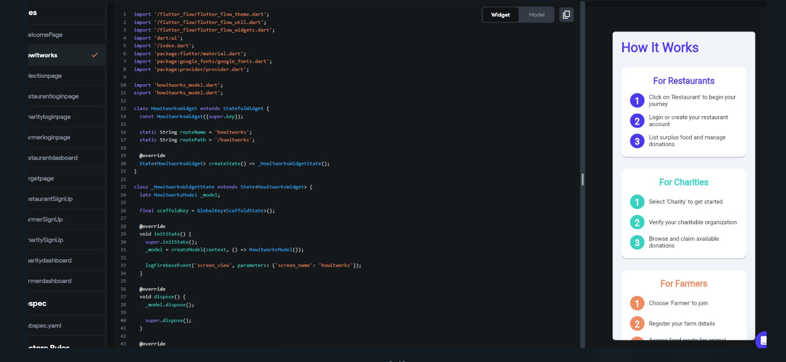
Implementation
Selection PAGE:
Informative onboarding screen guiding users based on their roles: Restaurant, Charity, or Farmer.
Uses a clean UI with iconography and sectioned layouts to enhance clarity and user experience.
Step-by-step instructions are provided to help each user type understand the flow and actions required.
Notes:
New Courses replaced with New Programmes

Slide 5
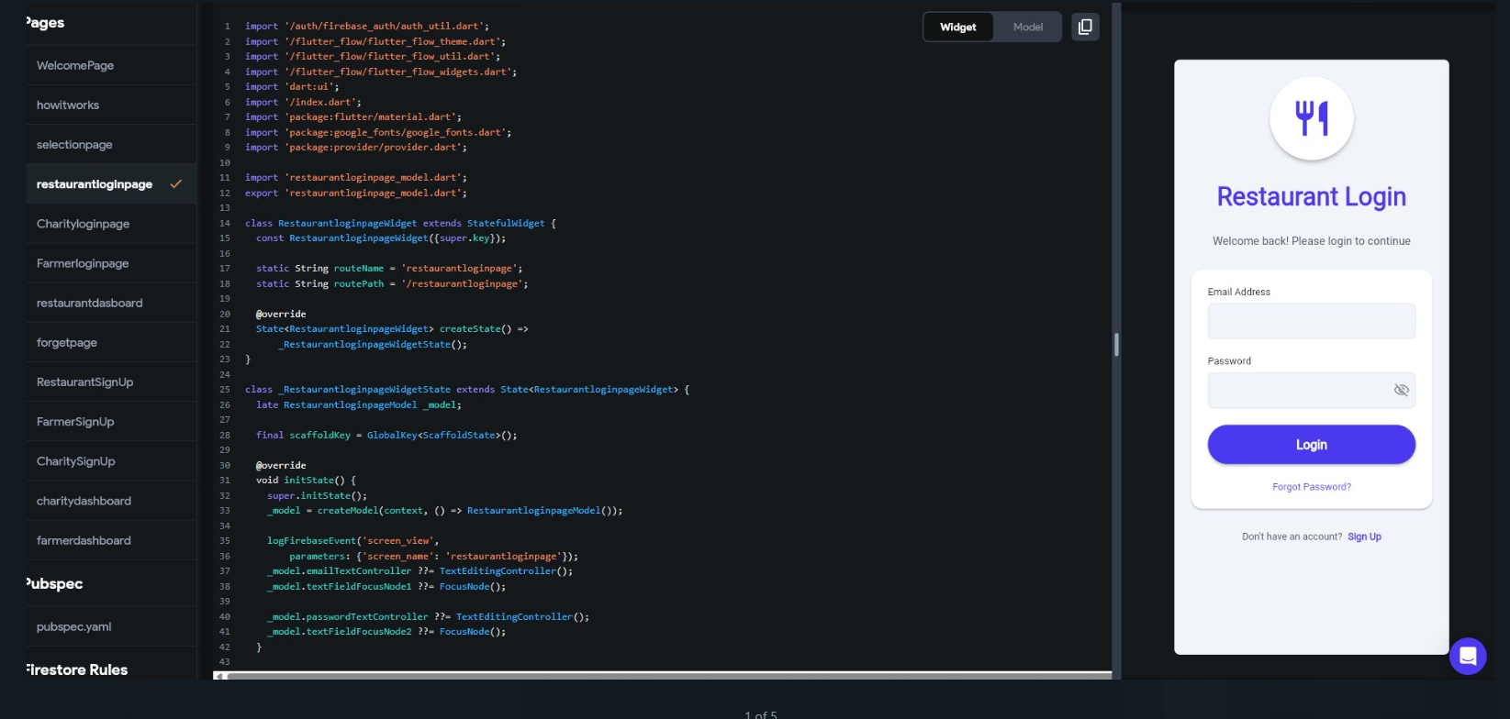
Implementation
LOGIN PAGE:
Custom Flutter login screen tailored for restaurant users with a clean, user-friendly UI.
Firebase Authentication handles secure email/password login and tracks login events.
State management and form control implemented using controllers and focus nodes for smooth user interaction and validation.
Notes:
New Courses replaced with New Programmes

Slide 6
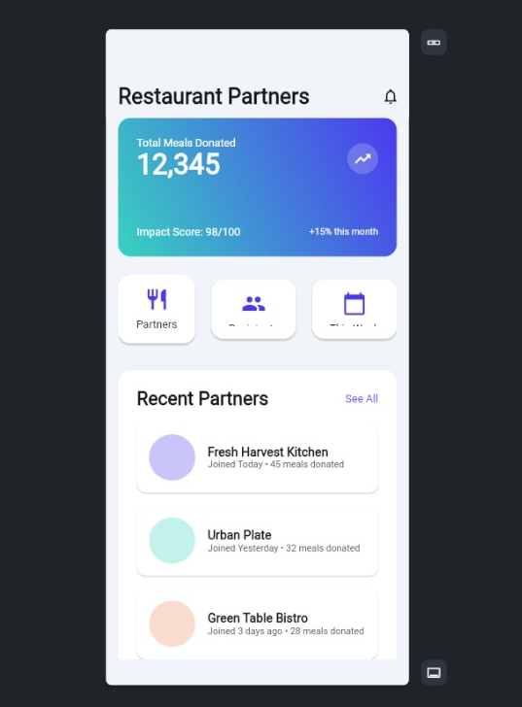
Implementation
RESTAURANT DASHBOARD PAGE:
Overview dashboard displaying key metrics like total meals donated, monthly growth rate, and impact score to encourage continued contribution.
Quick navigation icons provide fast access to partner management, collaboration, and scheduling features.
Recent partners section showcases new contributors, promoting transparency and community engagement.
Notes:
New Courses replaced with New Programmes

Slide 7
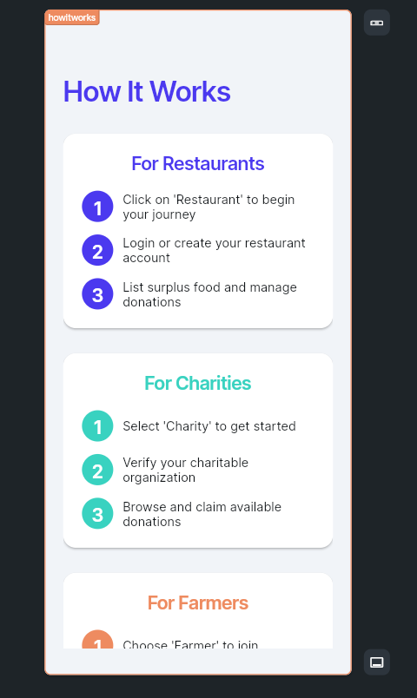
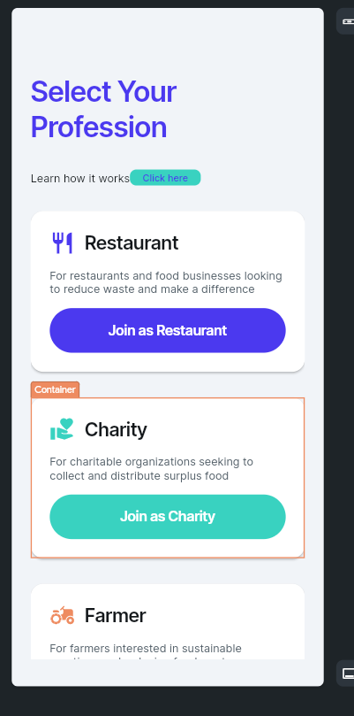
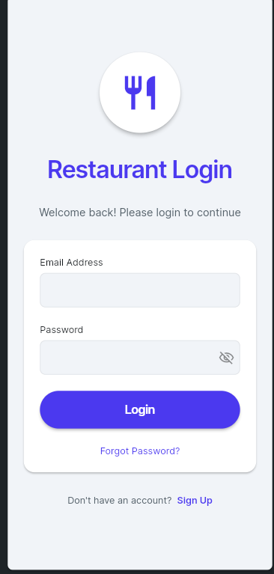
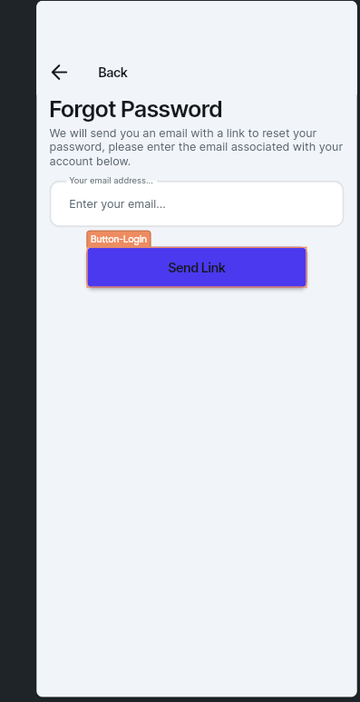
UI INTERFACE
Notes:
New Courses replaced with New Programmes

Slide 8
KEY FEATURES
Role-Based Onboarding Separate login/signup for Restaurants, Charities, and Farmers for a personalized experience.
Smart Food Routing Leftover but edible food is sent to Charities, while rotten or expired food is directed to Farmers for manure.
Real-Time Donation Management Track meals donated, view impact scores, and manage surplus food listings with ease.
Verified Network System All users (especially Charities) go through a verification process to ensure authenticity and safety.
Partner Communication Hub In-app messaging/connect feature allows direct contact between Restaurants, Charities, and Farmers.
Impact Analytics Dashboard View statistics like total meals donated, food saved, environmental impact, and monthly growth.
Notes:
New Courses replaced with New Programmes

Slide 9
ABOUT THE PROBLEM
Problems Identified & Issues:
Food waste harms the environment and contributes to climate change.
India faces massive food waste, leading to economic losses and hunger.
Urban food waste strains waste management systems.
Edible food is discarded while farmers lack organic compost.
Need for a Solution:
A system is needed to redistribute surplus food and recycle waste.
Edible food should go to charities and orphanages.
Inedible food products should be composted for farmers.
It reduces waste and is beneficial for the environment.
Existing Solutions & Gaps:
Existing food donation and composting programs lack efficiency and coordination.
Manual collection causes logistical issues and waste. –
Our platform brings together restaurants, charities and farmers.
It ensures efficient food redistribution and supports sustainable agriculture.
Notes:
New Courses replaced with New Programmes

Slide 10
Problem Statement
Problem Definition:
Millions of tons of edible food are wasted globally while hunger persists.
Companies lack an effective system for donating surplus food.
Beneficiaries have difficulty accessing real-time information on food availability.
Today’s systems are fragmented, slow and outdated.
Why is it important?
Reducing food waste helps fight hunger.
Efficient redistribution reduces environmental impacts.
Businesses can easily donate surplus food.
Recycling waste materials supports sustainable agriculture.
Expected Impact:
More food reaches those in need.
It reduces food waste and damage to the environment.
Transparent donation and fundraising process.
Scalable, technology-driven solutions that deliver long-term impact.
Notes:
New Courses replaced with New Programmes

Slide 11
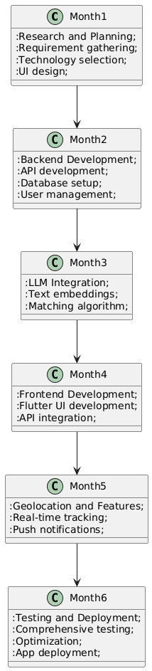
Project Timeline
Notes:
New Courses replaced with New Programmes

Slide 12
Results & Impact
Results:
A user-centric mobile platform that bridges the gap between surplus food providers and those in need.
A robust, AI-driven matching system powered by LLMs, ensuring surplus food is allocated to the most suitable recipients.
A geolocation-enabled logistics system that improves the efficiency of food redistribution, reducing waste and aiding communities in need.
Impact:
Bringing together restaurants, charities and farmers to get surplus food to people in need while minimizing landfill waste.
Supporting businesses (corporate social responsibility), charities and farmers by providing researchers with data on food waste patterns and sustainability.
Supermarkets, homes, AI predictions and blockchain can be integrated to increase transparency and build a zero waste ecosystem.
Notes:
New Courses replaced with New Programmes

Slide 13
CONCLUSION
Reduces Food Waste: "Waste to Worth" efficiently minimizes food waste by redirecting surplus and rotten food to charities and farmers.
Sustainable Solutions: Supports environmentally friendly practices by repurposing food waste as organic manure, benefiting agriculture.
Community Impact: Directly helps feed underprivileged individuals, fostering stronger community bonds and social responsibility.
Economic Benefits: Provides restaurants with a cost-effective waste management solution, while supporting farmers with free organic material.
Scalability: The app has the potential for expansion to multiple cities, increasing its social, environmental, and economic impact.
Long-Term Vision: Promotes a circular economy where food waste is viewed as a valuable resource rather than a burden, contributing to sustainable development.
Notes:
New Courses replaced with New Programmes

Slide 14
SUMMARY
App Name: "Waste2Worth"
Purpose: Connects restaurants, charities, and farmers to reduce food waste and promote sustainability.
Key Features:
Restaurants: Donate leftover food to local charities.
Charities: Claim surplus food to feed those in need.
Farmers: Receive rotten food for use as organic manure.
Food Waste Management:
Edible Leftovers: Donated to charities for distribution.
Rotten Food: Sent to farmers for composting or use as fertilizer.
Farmer-Restaurant Interaction: Farmers contact restaurants through the app to collect organic waste.
Sustainability:
Reduces landfill waste by reusing food.
Supports sustainable farming practices with free organic manure.
Community Impact:
Helps feed the underprivileged by redistributing surplus food.
Encourages collaboration between local sectors: restaurants, farmers, and charities.
Economic Benefits:
Reduces food waste disposal costs for restaurants.
Provides farmers with free organic material for fertilization.
Notes:
New Courses replaced with New Programmes

Slide 15
THANK YOU

